Slide 1
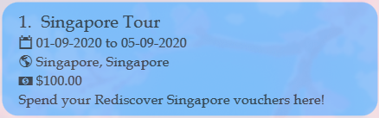
Name
Start and end dates
Budget
Location(s)
Description

Slide 2
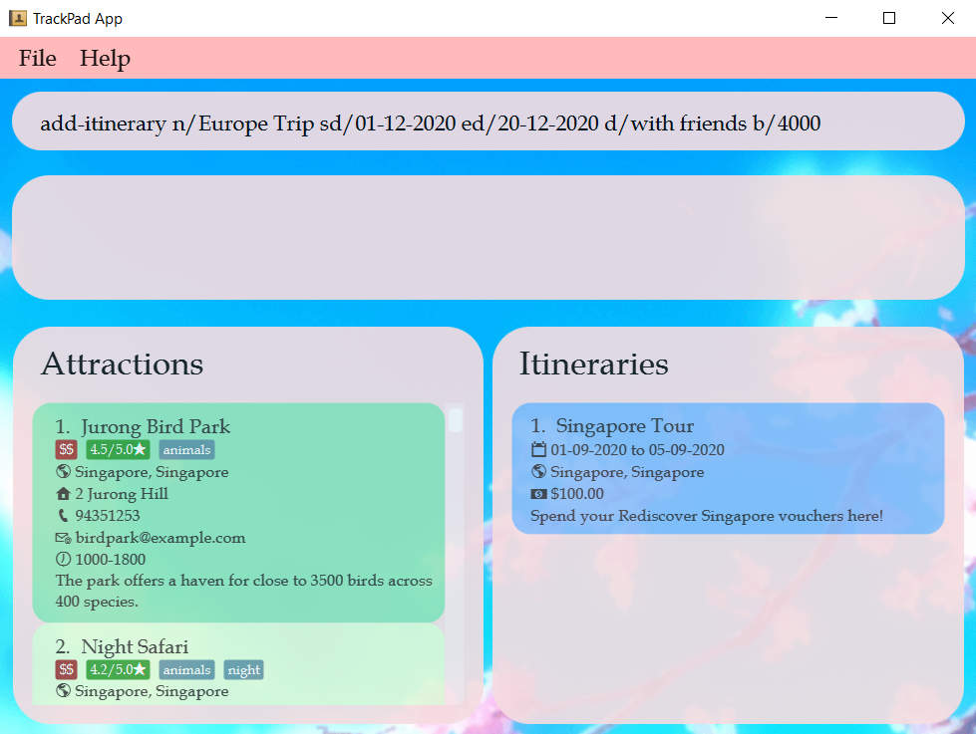
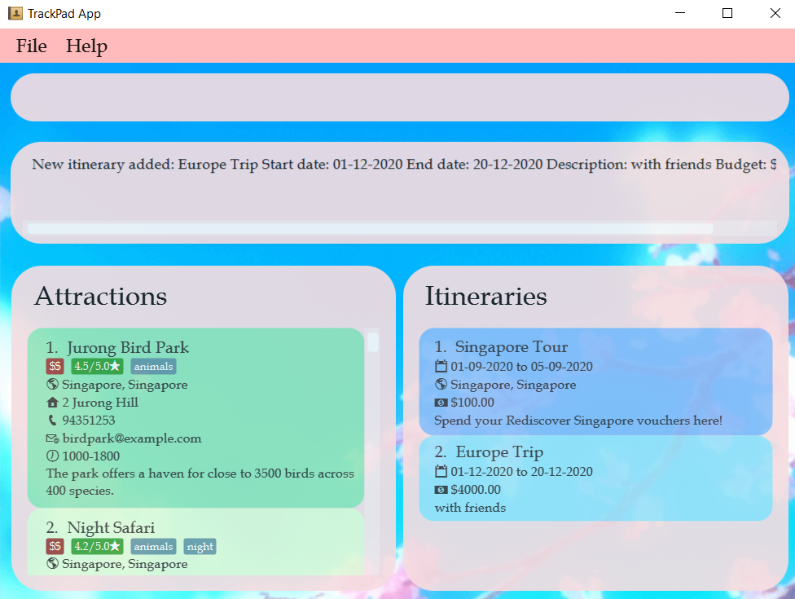
Enter command here
New itinerary added

Slide 3
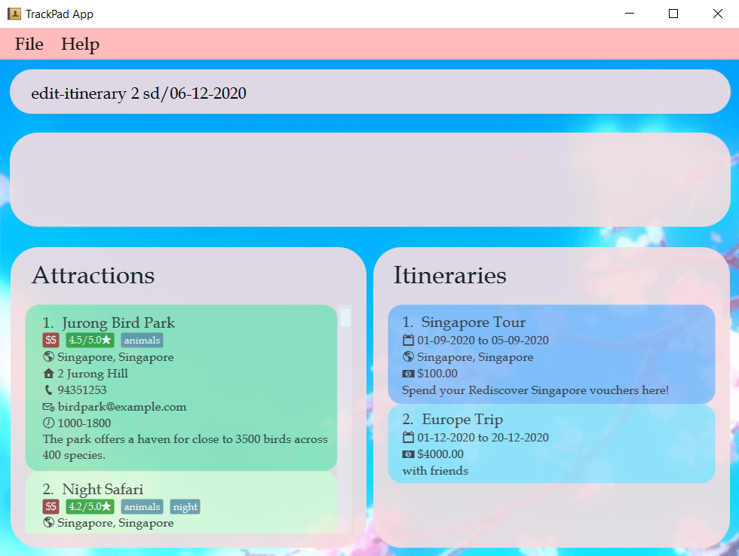
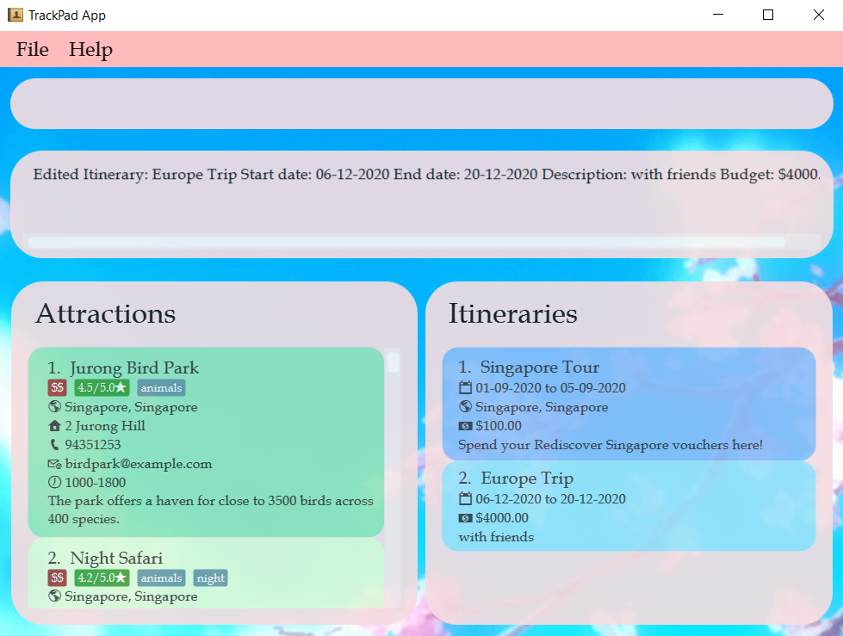
Enter command here
Start date to edit
Edited start date

Slide 4
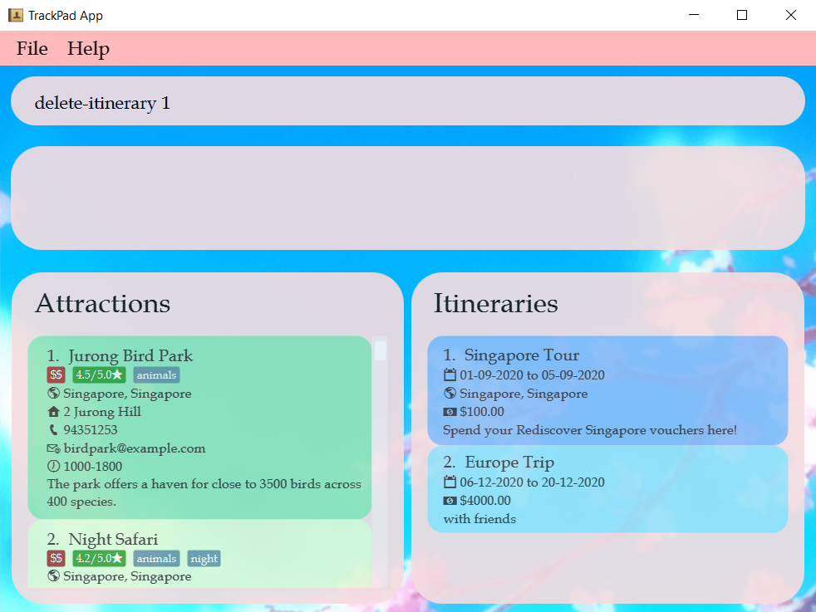
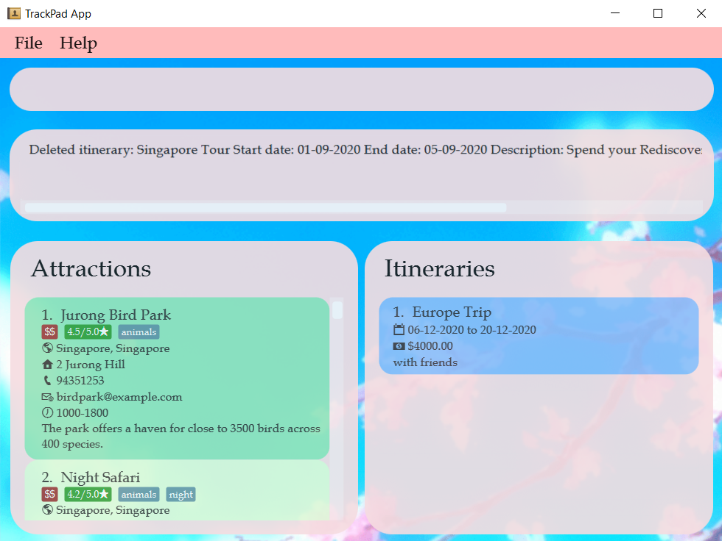
Enter command here
Itinerary to delete
First itinerary deleted

Slide 5
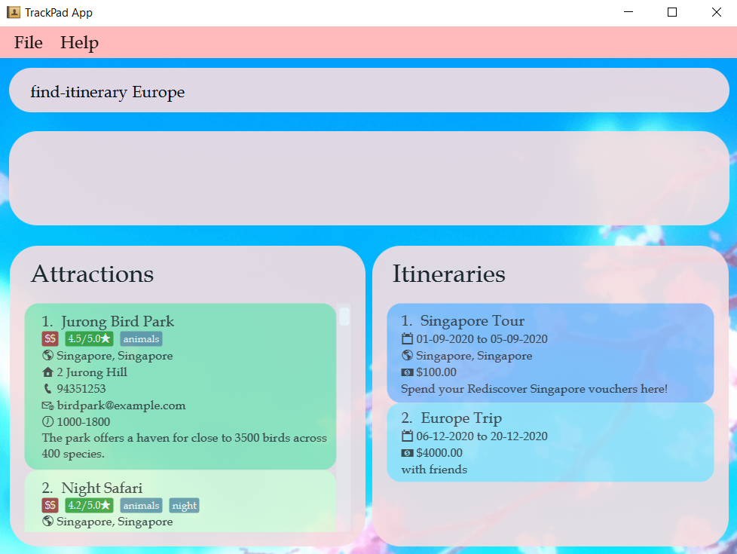
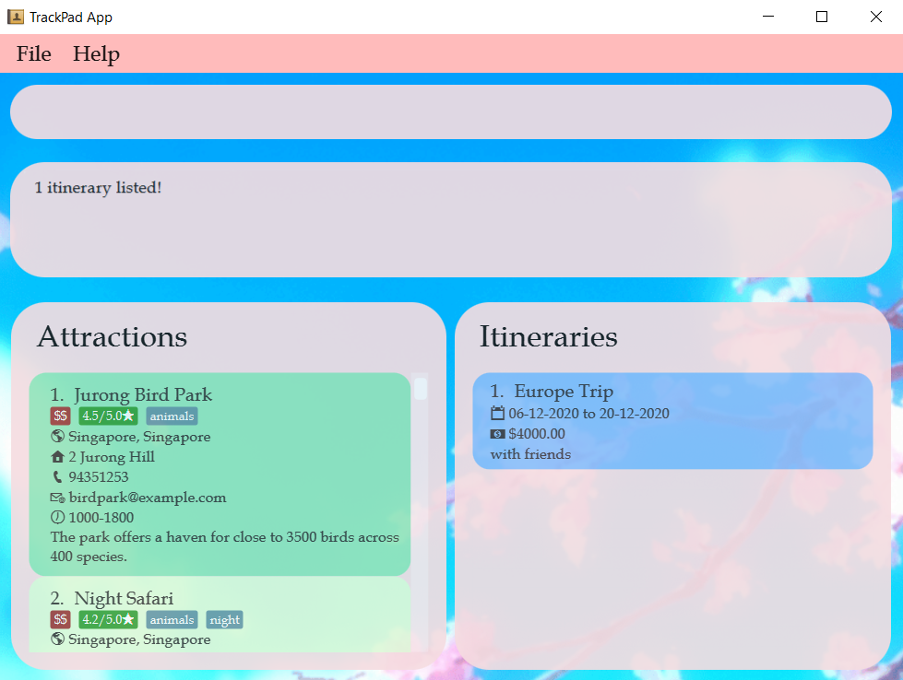
Enter command here
Itinerary to find
Found itinerary

Slide 6
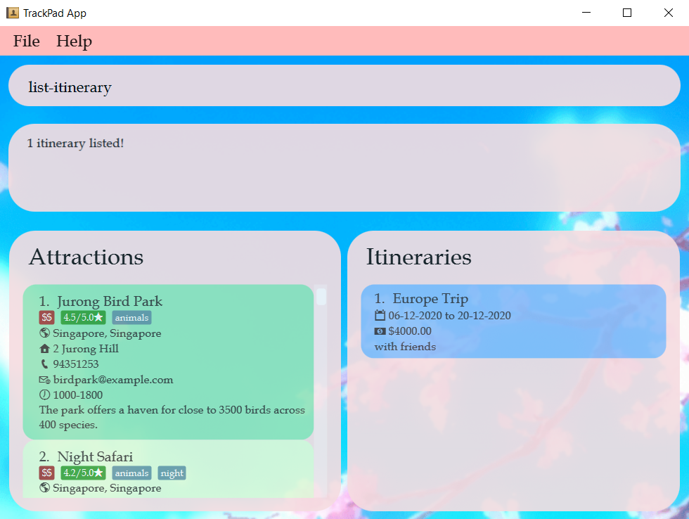
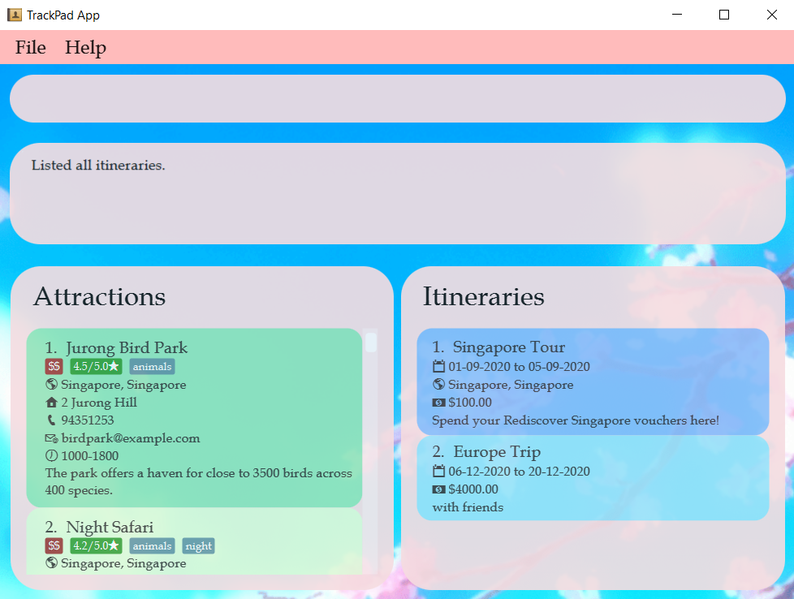
Enter command here
Only 1 itinerary shown
All itineraries listed

Slide 7

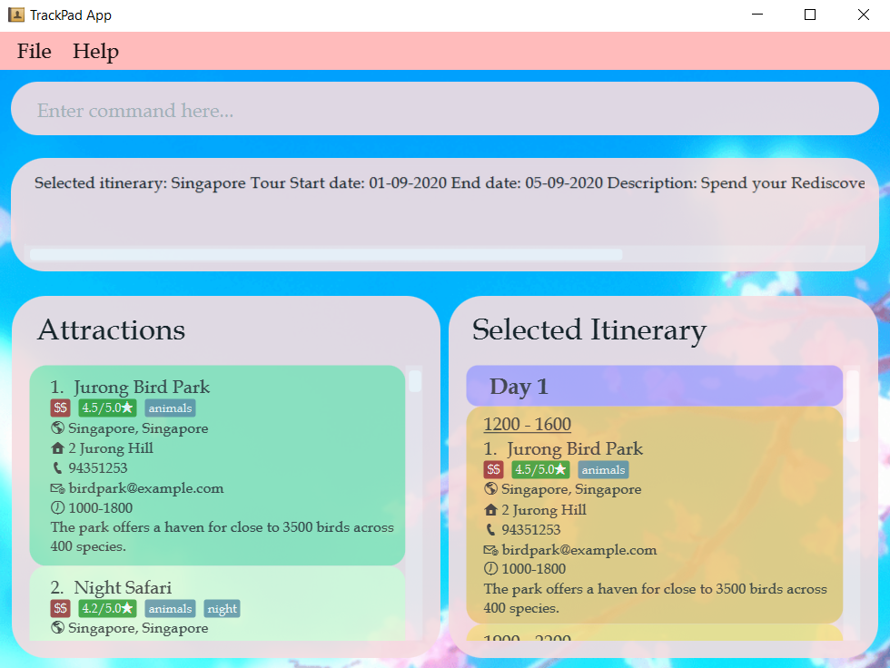
Enter command here
Itinerary to select
Detailed view of selected itinerary

Slide 8

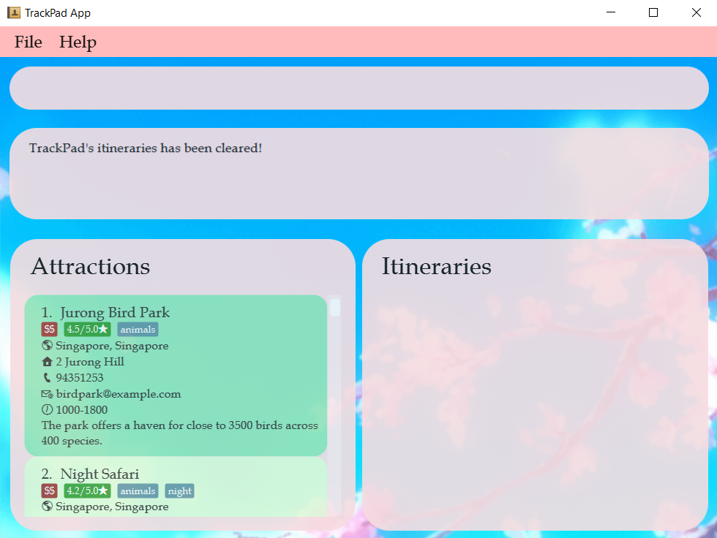
Enter command here
All itineraries
All itineraries cleared

